Slide 1
Meta-Reasoning

Slide 2
Metacognition
Learning by Correcting Mistakes
Meta-Reasoning
Ethics in Artificial Intelligence

Slide 3
Lesson Preview
Mistakes in knowledge, reasoning, and learning
Gaps in knowledge and reasoning
Strategy selection and integration
Meta-meta-reasoning?
Goal-based autonomy

Slide 4
is
Object
Cup
is
enables
Object
Stable
Object
Drinking
has
Object
Bottom
is
Bottom
Flat
carries
Liquids
is
Object
Object
Liftable
made-of
Object
Porcelain
has
is
has
Object
Concavity
Object
Light
Object
Decoration
has
Object
Handle

Slide 5
Cognitive System
Metacognition
Deliberation
Reasoning
Input
Output
Learning
Memory
Reaction

Slide 6
Current State
Goal State
A
A
B
B
C
C
D
D
A on B
B on C
C on Table
D on Table
Δ = 1
A on B
B on C
C on D
D on Table

Slide 7
Cognitive System
Metacognition
Deliberation
Reasoning
Input
Output
Learning
Memory
Reaction

Slide 8
is
Object
Cup
enables
Object
Drinking
is
Object
Manipulable
is
Object
Orientable
carries
Liquids
is
Object
Object
Liftable
has
is
Object
Concavity
Object
Light
is
Handle
Fixed
has
Object
Handle

Slide 9
is
Object
Mug
protects
against
is
enables
Object
Stable
Object
Drinking
Object
Heat
limits
Object
Heat transfer
has
Object
Thick sides
made-of
Object
Thick sides

Slide 10
is
Object
Mug
protects
against
is
enables
Oven Mitt
Object
Stable
Object
Drinking
Object
Heat
limits
Object
Heat transfer
has
Object
Thick sides
made-of
Object
Thick sides

Slide 11
Current State
Goal State
A
A
B
B
C
C
D
D
A on B
B on C
C on Table
D on Table
Δ = 1
A on B
B on C
C on D
D on Table

Slide 12
Cognitive System
Metacognition
Deliberation
Reasoning
Input
Output
Learning
Memory
Reaction

Slide 13
is
Object
Cup
is
enables
Object
Stable
Object
Drinking
has
Object
Bottom
is
Bottom
Flat
carries
Liquids
is
Object
Object
Liftable
made-of
Object
Porcelain
has
is
has
Object
Concavity
Object
Light
Object
Decoration
has
Object
Handle

Slide 14
Cognitive System
Metacognition
Deliberation
Reasoning
Input
Output
Learning
Memory
Reaction

Slide 15
Case-Based Reasoning
Constraint Propagation
Generate & Test
Means-Ends Analysis
Analogical Reasoning
Planning
Problem Reduction

Slide 16
Metacognition
Case-Based Reasoning
Constraint Propagation
Generate & Test
Means-Ends Analysis
Analogical Reasoning
Planning
Problem Reduction

Slide 17
Metacognition
Learning by
Recording Cases
Classification
Explanation-Based
Learning
Incremental
Concept Learning
Version Spaces

Slide 18
Metacognition
Case-Based Reasoning
Constraint Propagation
Generate & Test
Means-Ends Analysis
Analogical Reasoning
Planning
Problem Reduction

Slide 19
Metacognition
Case-Based Reasoning

Slide 20
Metacognition
Retrieval
Case-Based Reasoning
Adaptation
Evaluation
Storage

Slide 21
Metacognition
Retrieval
Case-Based Reasoning
Adaptation
Evaluation
Storage

Slide 22
Metacognition
Retrieval
By model?
Case-Based Reasoning
Adaptation
By rules?
Recursively?
Evaluation
Storage

Slide 23
Metacognition
Retrieval
Rule 1?
Case-Based Reasoning
Adaptation
By rules?
Rule 2?
Rule 3?
Evaluation
Storage

Slide 24
Metacognition
Case-Based Reasoning
Constraint Propagation
Generate & Test
Means-Ends Analysis
Analogical Reasoning
Planning
Problem Reduction

Slide 25
Is this a good way to think about levels of metacognition?
ο Yes, because it is possible to think about every successive level.
ο No, because there is a maximum level of metacognition possible.
ο No, because each level of metacognition is conceptually identical, so they are better represented as self-referential.
ο No, because there is no need to distinguish between metacognition and deliberation.
N-Metacognition
…
…
Meta-Metacognition
Metacognition
Deliberation

Slide 26
Is this a good way to think about levels of metacognition?
ο Yes, because it is possible to think about every successive level.
ο No, because there is a maximum level of metacognition possible.
ο No, because each level of metacognition is conceptually identical, so they are better represented as self-referential.
ο No, because there is no need to distinguish between metacognition and deliberation.
Metacognition
Deliberation

Slide 27
Metacognition
Deliberation
Reasoning
Input
Output
Learning
Memory
Reaction

Slide 28
is
Object
Cup
enables
Object
Drinking
is
Object
Manipulable
is
Object
Orientable
carries
Liquids
is
Object
Object
Liftable
has
is
Object
Concavity
Object
Light
is
Handle
Fixed
has
Object
Handle

Slide 29
Goal: Painted(Ladder)
Goal: Painted(Ceiling)
On(Robot, Floor) ˄
Dry(Ladder) ˄ Dry(Ceiling)
On(Robot, Floor) ˄
Dry(Ladder) ˄ Dry(Ceiling)
paint-ladder
climb-ladder
On(Robot, Floor) ˄
¬Dry(Ladder) ˄ Dry(Ceiling) ˄ Painted(Ladder)
On(Robot, Ladder) ˄
Dry(Ladder) ˄ Dry(Ceiling)
paint-ceiling
climb-ladder:
Precondition:
On(Robot, Floor) ˄
Dry(Ladder)
Postcondition:
On(Robot, Ladder)
On(Robot, Ladder) ˄
Dry(Ladder) ˄ ¬Dry(Ceiling) ˄ Painted(Ceiling)

Slide 30
(r8) If two operators selected and one has an episode with result homerun
then prefer other operator
inning : 5th
portion : bottom
game : 131
weather : windy
runners : 1st, 3rd
outs : 1
batter : Pierzynski
average : .283
bats : left-handed
score : 1-4
goal : pitch
pitch : throw-fast-ball
result : homerun
“chunking”

Slide 31
Version Spaces
Specific
General

Slide 32
Data Space
D₁
D₂
D₃
D₄
D₅
D₆
D₇
D₈
D₉
…
D_{N}
Hypothesis Space
H₁
H₂
H₃
H₄
H₅
H₆
H₇
H₈
H₉
…
H_{N}
Treatment Space
T₁
T₂
T₃
T₄
T₅
T₆
T₇
T₈
T₉
…
T_{N}
Map
Abstract
Refine

Slide 33
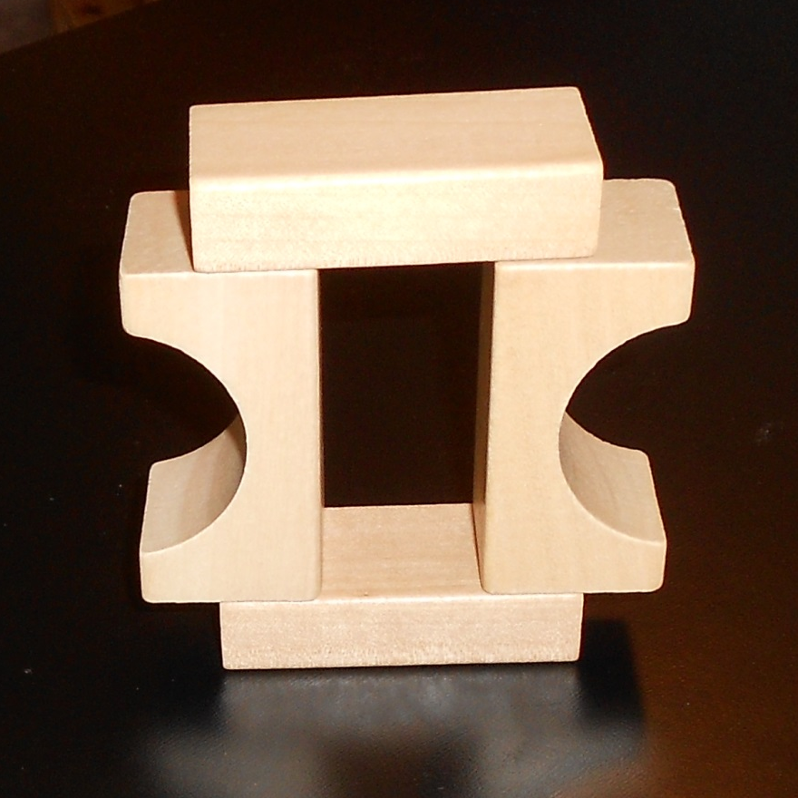
Is this a foo?
ο Yes
ο No

Slide 34
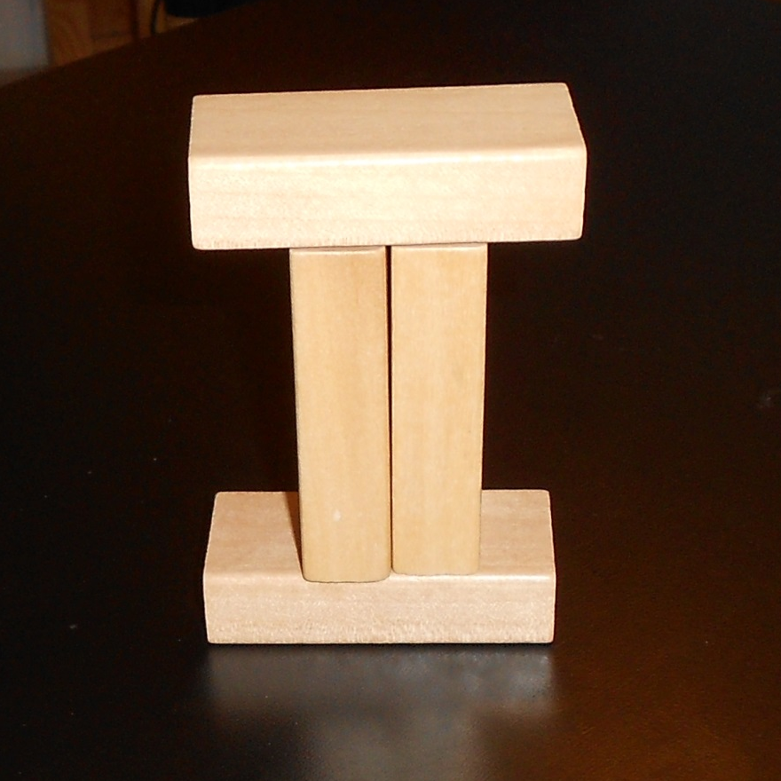
This is not a foo.
Current Concept
Brick
supports
supports
¬touches
Brick
Brick
¬touches
supports
supports
Brick
Modify the concept on the right to specialize based on this example.

Slide 35
Assignment
How would you use meta-reasoning to design an agent that could answer Raven’s progressive matrices?

Slide 36
To recap…
Resolving mistakes and gaps
Strategy selection and integration
Meta-meta-reasoning?
Goal-based autonomy

